Slide 1
PpPCO Tests with AttB primers

Slide 2
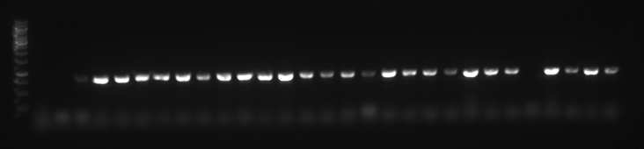
Ladder | C3 | 4pcoKO | Pp-7-1 | Pp-7-2 | Pp-7-3 | Pp-7-4 | Pp-7-5 | Pp-7-6 | Pp-7-7 | Pp-7-8 | Pp-7-9 | Pp-7-10 | Pp-7-11 | Pp-7-12 | Pp-7-13 | Pp-7-14 | Pp-7-15 | Pp-7-17 | Pp-7-18 | Pp-7-20 | Pp-7-22 | Pp-10-1 | Pp-10-2 | Pp-10-3 | Pp-10-4 | Pp-10-5 | Pp-10-6 | Pp-10-7 | Pp-10-8

Slide 3
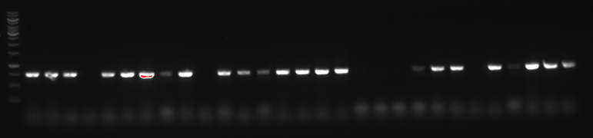
Ladder | Pp-10-9 | Pp-10-10 | Pp-10-11 | Pp-10-12 | Pp-10-13 | Pp-10-14 | Pp-10-15 | Pp-10-16 | Pp-10-17 | Pp-10-18 | Pp-10-19 | Pp-10-20 | Pp-10-21 | Pp-10-22 | Pp-10-23 | Pp-10-24 | Pp-10-25 | Pp-10-26 | Pp-10-27 | Pp-10-28 | Pp-10-29 | Pp-10-30 | Pp-10-31 | Pp-10-32 | Pp-10-33 | Pp-10-34 | Pp-10-35 | Pp-10-36 | Pp-10-37

Slide 4
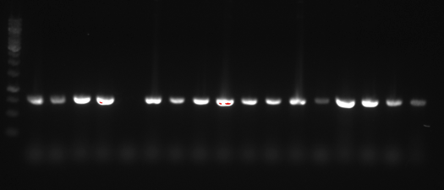
Ladder | Pp-10-38 | Pp-10-39 | Pp-2-2 | Pp-5-1 | Pp-7-28 | Pp-9-1 | Pp-7-25 | Pp-8-1 | Pp-1-1 | Pp-7-27 | Pp-7-26 | Pp-7-30 | Pp-7-23 | Pp-7-24 | Pp-8-2 | Pp-7-31 | Pp-7-29

